Slide 1
Introduction to Computers, Programs, and Java
This Presentation is taken from book :Y.Deniel Liang Introduction to Java Programming ,Tenth Edition
Prof : Ronak Sheth

Slide 2
Programs
Computer programs, known as software, are instructions to the computer.
You tell a computer what to do through programs. Without programs, a computer is an empty machine. Computers do not understand human languages, so you need to use computer languages to communicate with them.
Programs are written using programming languages.

Slide 3
Interpreting/Compiling Source Code
A program written in a high-level language is called a source program or source code. Because a computer cannot understand a source program, a source program must be translated into machine code for execution. The translation can be done using another programming tool called an interpreter or a compiler.

Slide 4

Interpreting Source Code
An interpreter reads one statement from the source code, translates it to the machine code or virtual machine code, and then executes it right away, as shown in the following figure. Note that a statement from the source code may be translated into several machine instructions.

Slide 5

Compiling Source Code
A compiler translates the entire source code into a machine-code file, and the machine-code file is then executed, as shown in the following figure.

Slide 6
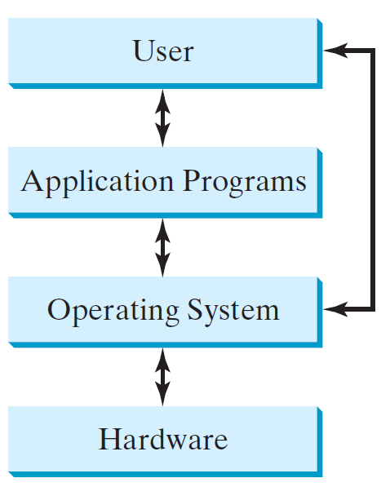
Operating Systems
The operating system (OS) is a program that manages and controls a computer’s activities. The popular operating systems for general-purpose computers are Microsoft Windows, Mac OS, and Linux. Application programs, such as a Web browser or a word processor, cannot run unless an operating system is installed and running on the computer.

Slide 7
Why Java?
The answer is that Java enables users to develop and deploy applications on the Internet for servers, desktop computers, and small hand-held devices. The future of computing is being profoundly influenced by the Internet, and Java promises to remain a big part of that future. Java is the Internet programming language.
Java is a general purpose programming language.
Java is the Internet programming language.

Slide 8
Java, Web, and Beyond
Java can be used to develop standalone applications.
Java can be used to develop applications running from a browser.
Java can also be used to develop applications for hand-held devices.
Java can be used to develop applications for Web servers.

Slide 9
JDK Editions
Java Standard Edition (J2SE)
  J2SE can be used to develop client-side standalone applications or applets.
Java Enterprise Edition (J2EE)
  J2EE can be used to develop server-side applications such as Java servlets, Java ServerPages, and Java ServerFaces.
Java Micro Edition (J2ME).
  J2ME can be used to develop applications for mobile devices such as cell phones.
This book uses J2SE to introduce Java programming.

Slide 10
Popular Java IDEs
NetBeans
Eclipse

Slide 11
A Simple Java Program
Listing 1.1
// This program prints Welcome to Java!
public class Welcome {
public static void main(String[] args) {
System.out.println("Welcome to Java!");
}
}

Slide 12
Trace a Program Execution
animation
Enter main method
// This program prints Welcome to Java!
public class Welcome {
public static void main(String[] args) {
System.out.println("Welcome to Java!");
}
}

Slide 13
Trace a Program Execution
animation
Execute statement
// This program prints Welcome to Java!
public class Welcome {
public static void main(String[] args) {
System.out.println("Welcome to Java!");
}
}

Slide 14

Trace a Program Execution
animation
// This program prints Welcome to Java!
public class Welcome {
public static void main(String[] args) {
System.out.println("Welcome to Java!");
}
}
print a message to the console

Slide 15
Anatomy of a Java Program
Class name
Main method
Statements
Statement terminator
Reserved words
Comments
Blocks

Slide 16
Class Name
Every Java program must have at least one class. Each class has a name. By convention, class names start with an uppercase letter. In this example, the class name is Welcome.
// This program prints Welcome to Java!
public class Welcome {
public static void main(String[] args) {
System.out.println("Welcome to Java!");
}
}

Slide 17
Main Method
Line 2 defines the main method. In order to run a class, the class must contain a method named main. The program is executed from the main method.
// This program prints Welcome to Java!
public class Welcome {
public static void main(String[] args) {
System.out.println("Welcome to Java!");
}
}

Slide 18
Statement
A statement represents an action or a sequence of actions. The statement System.out.println("Welcome to Java!") in the program in Listing 1.1 is a statement to display the greeting "Welcome to Java!“.
// This program prints Welcome to Java!
public class Welcome {
public static void main(String[] args) {
System.out.println("Welcome to Java!");
}
}

Slide 19
Statement Terminator
Every statement in Java ends with a semicolon (;).
// This program prints Welcome to Java!
public class Welcome {
public static void main(String[] args) {
System.out.println("Welcome to Java!");
}
}

Slide 20
Reserved words
Reserved words or keywords are words that have a specific meaning to the compiler and cannot be used for other purposes in the program. For example, when the compiler sees the word class, it understands that the word after class is the name for the class.
// This program prints Welcome to Java!
public class Welcome {
public static void main(String[] args) {
System.out.println("Welcome to Java!");
}
}

Slide 21

Blocks
A pair of braces in a program forms a block that groups components of a program.

Slide 22

Special Symbols

Slide 23
{ … }
// This program prints Welcome to Java!
public class Welcome {
public static void main(String[] args) {
System.out.println("Welcome to Java!");
}
}

Slide 24
( … )
// This program prints Welcome to Java!
public class Welcome {
public static void main(String[] args) {
System.out.println("Welcome to Java!");
}
}

Slide 25
;
// This program prints Welcome to Java!
public class Welcome {
public static void main(String[] args) {
System.out.println("Welcome to Java!");
}
}

Slide 26
// …
// This program prints Welcome to Java!
public class Welcome {
public static void main(String[] args) {
System.out.println("Welcome to Java!");
}
}

Slide 27
" … "
// This program prints Welcome to Java!
public class Welcome {
public static void main(String[] args) {
System.out.println("Welcome to Java!");
}
}

Slide 28
Programming Style and Documentation
Appropriate Comments
Naming Conventions
Proper Indentation and Spacing Lines
Block Styles

Slide 29
Appropriate Comments
Include a summary at the beginning of the program to explain what the program does, its key features, its supporting data structures, and any unique techniques it uses.
Include your name, class section, instructor, date, and a brief description at the beginning of the program.

Slide 30
Naming Conventions
Choose meaningful and descriptive names.
Class names:
  Capitalize the first letter of each word in the name. For example, the class name ComputeExpression.

Slide 31
Proper Indentation and Spacing
Indentation
  Indent two spaces.
Spacing
  Use blank line to separate segments of the code.

Slide 32

Block Styles
Use end-of-line style for braces.

Slide 33
Programming Errors
Syntax Errors
  Detected by the compiler
Runtime Errors
  Causes the program to abort
Logic Errors
  Produces incorrect result

Slide 34
Syntax Errors
public class ShowSyntaxErrors {
public static main(String[] args) {
System.out.println("Welcome to Java);
}
}
ShowSyntaxErrors
Run

Slide 35
Runtime Errors
public class ShowRuntimeErrors {
public static void main(String[] args) {
System.out.println(1 / 0);
}
}
ShowRuntimeErrors
Run

Slide 36
Logic Errors
public class ShowLogicErrors {
public static void main(String[] args) {
System.out.println("Celsius 35 is Fahrenheit degree ");
System.out.println((9 / 5) * 35 + 32);
}
}

